Slide 1
JuliaEO - Global Workshop on Earth Observation with Julia 2024
Session:
POS2IDON: Pipeline for Ocean Features Detection with Sentinel-2
Andrea Giusti, Emanuel Castanho
AIR Centre
11.01.2024

Slide 2

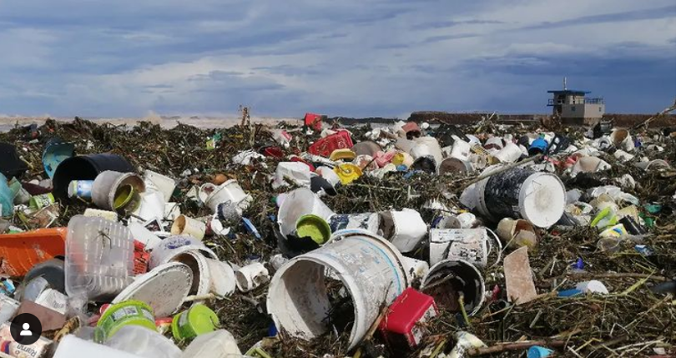
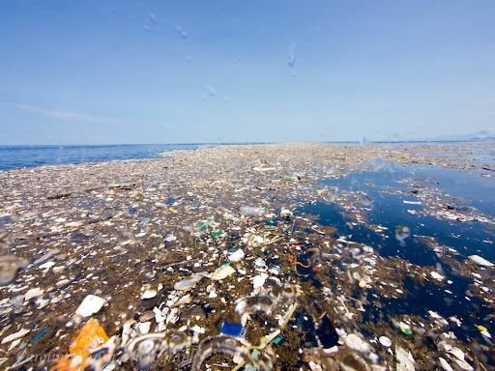
What is Marine Debris
Marine debris is defined as any persistent solid material that is manufactured or processed and directly or indirectly, intentionally or unintentionally, disposed of or abandoned into the marine environment
Plastics, metals, rubber, paper, textiles, and other lost or discarded items enter the ocean daily
One of today’s greatest's pollution problems
Kikai et al., 2020 Photos: Careline Power

Slide 3
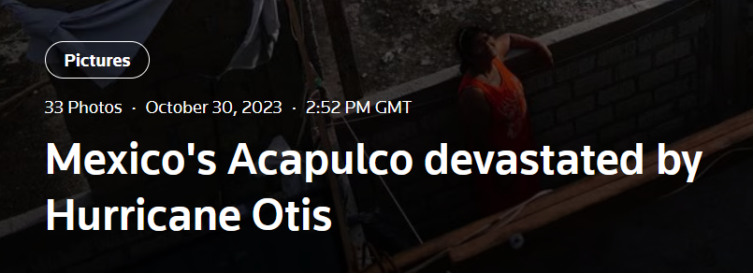
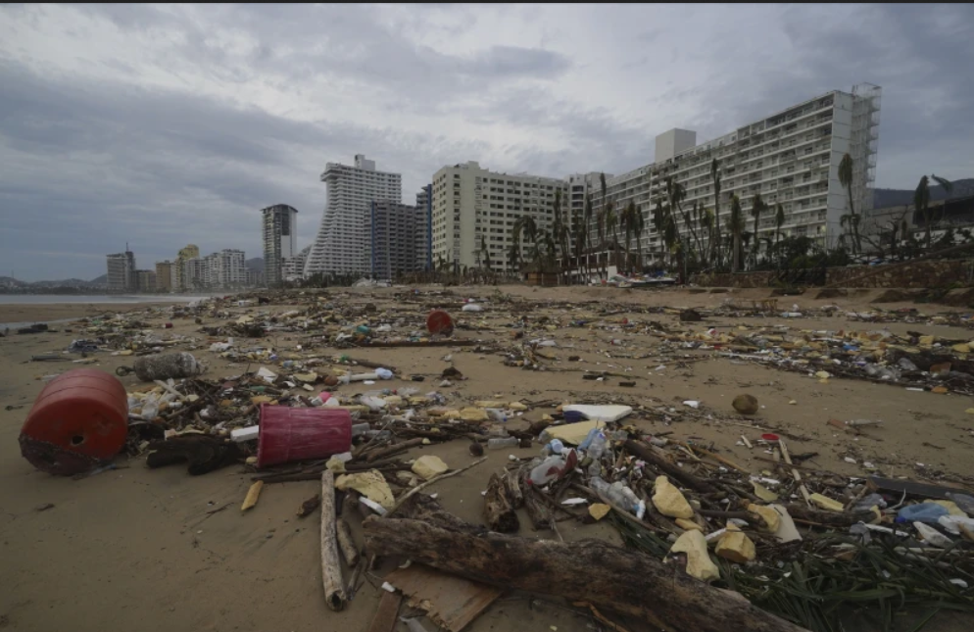
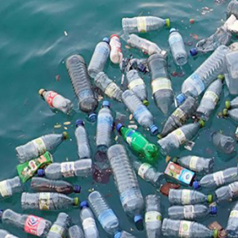
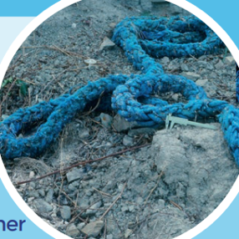
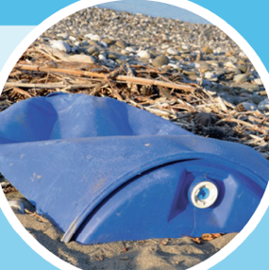
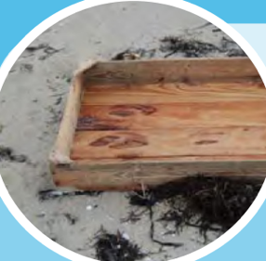
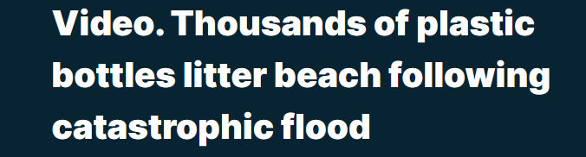
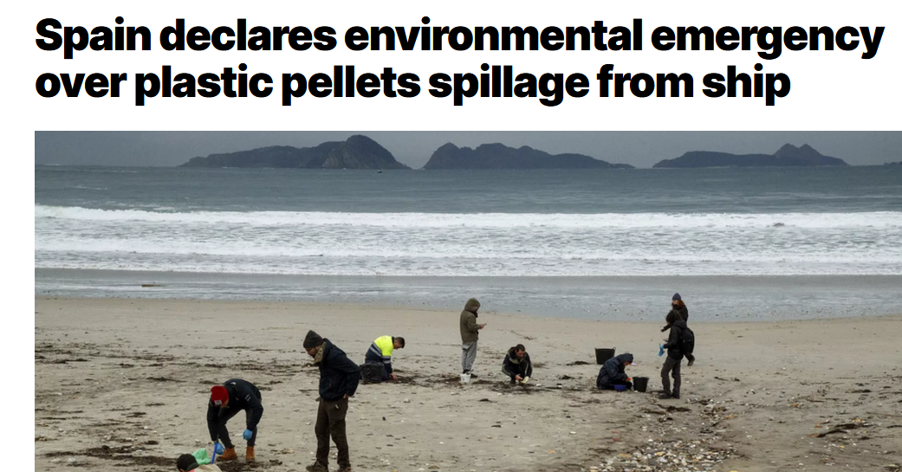
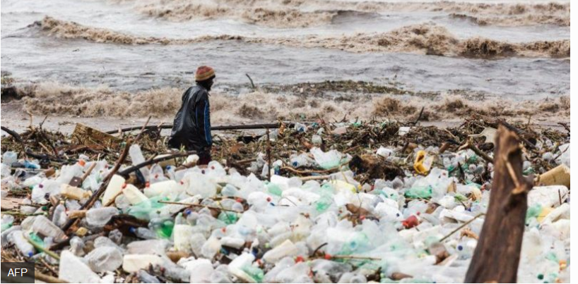
Marine debris are a strongly related to the problem of plastic pollution, since most debris are made of plastic.
They are a threat to the Environment, Navigation safety, Economy and Human health.
Flood events and other catastrophes can lead to great inputs into the ocean.

Slide 4
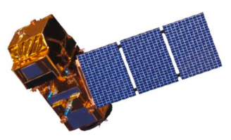
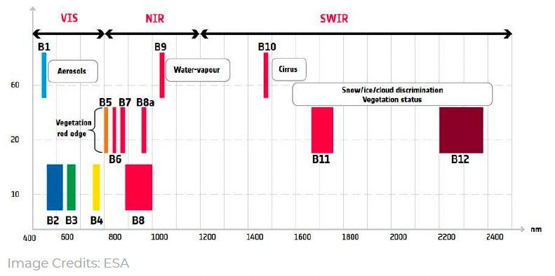
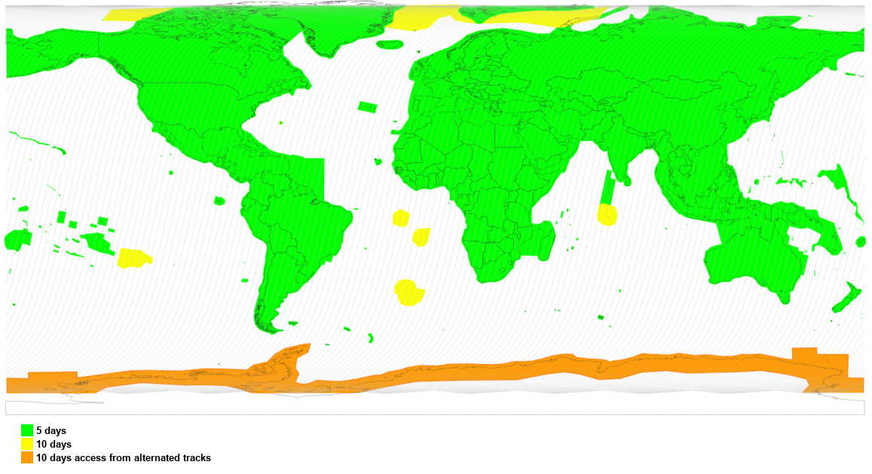
Satellite Technologies: Sentinel-2
Sentinel 2 provides a revolutionary way to study this…
- free-of-charge
- provides a trade between spatial resolution (10–20 m) and
- revisit frequency (5 days) for most coastal waters.
- has a global coverage.
- Multi-Spectral Instrument covers wavelengths of vis-NIR-SWIR, suitable for detecting and differentiating small floating matters.

Slide 5
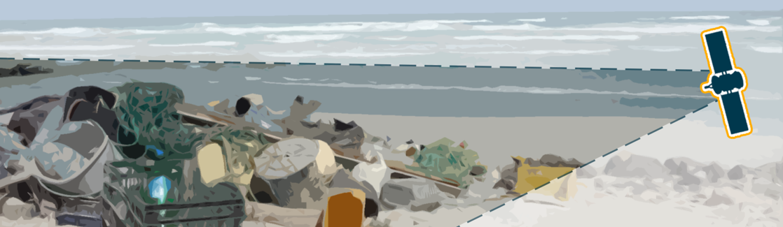
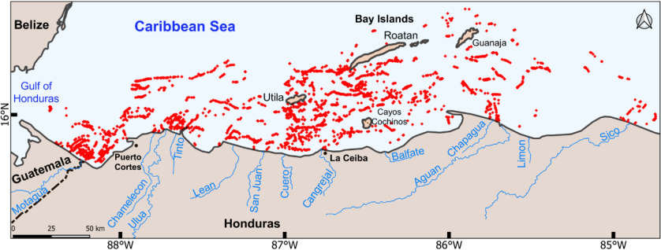
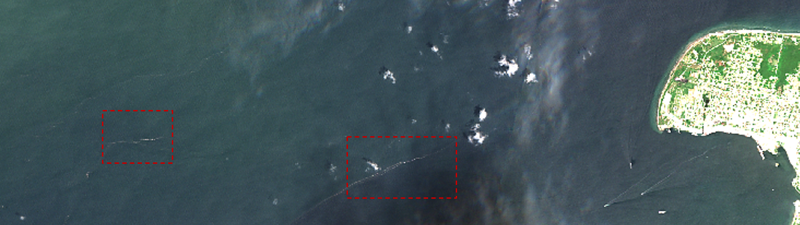
- monitor larger areas, as well as remotely, hard-to-reach areas
- provide uniform coverage, regular and longer temporal coverage and harmonized data collection
- support effective monitoring for management and remediation policies.
- be a cost-effective and replicable solution
Image Credits: European Space Agency, Katerina Kikaki et.al,2020

Slide 6
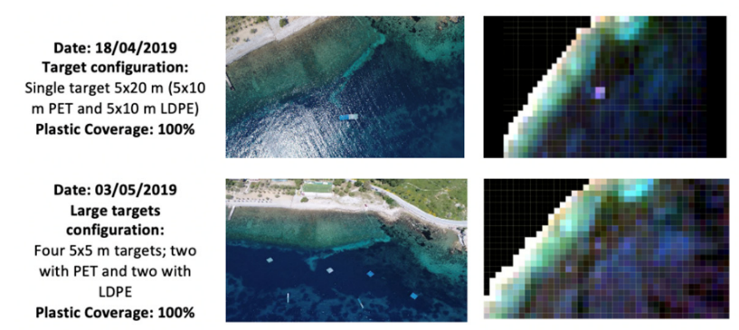
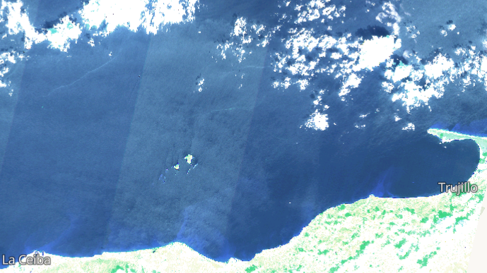
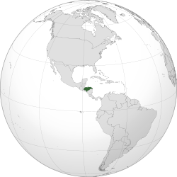
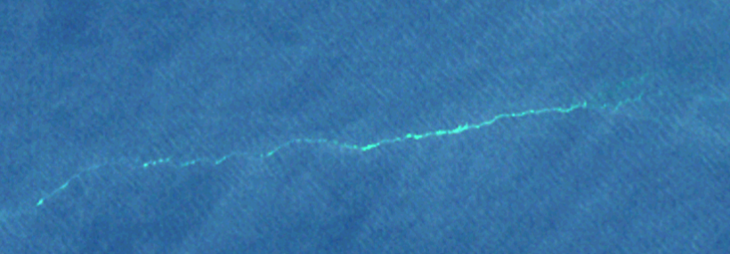
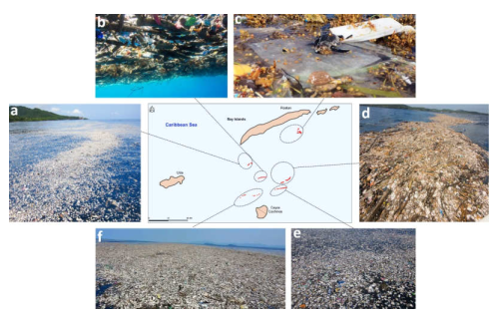
Ocean Features Detection
Marine Debris are typically seen as “bright” features…
Topouzelis et al., 2020
Kikai et al., 2020 Photos: Careline Power

Slide 7
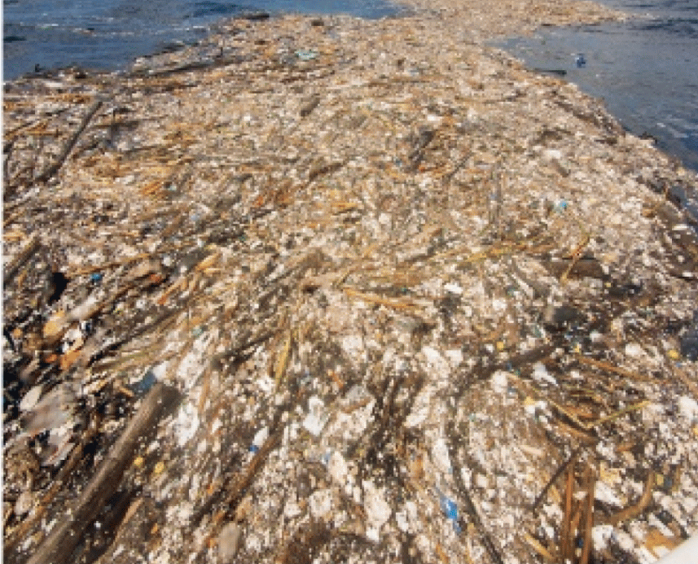
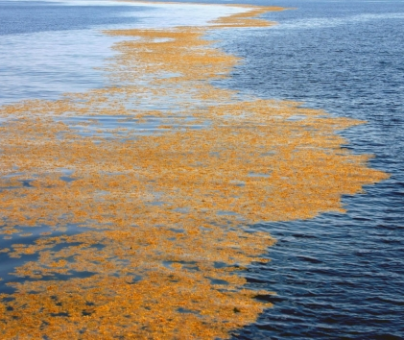
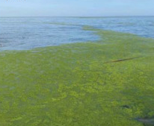
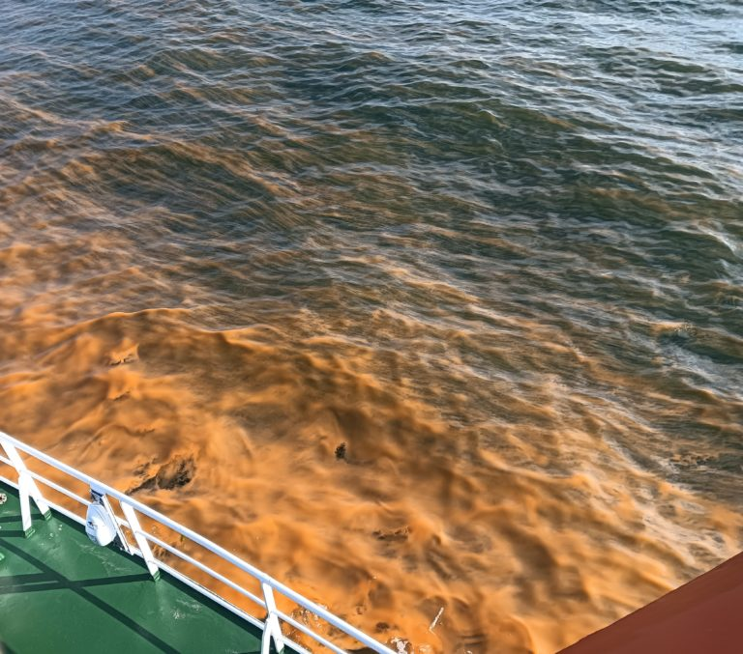
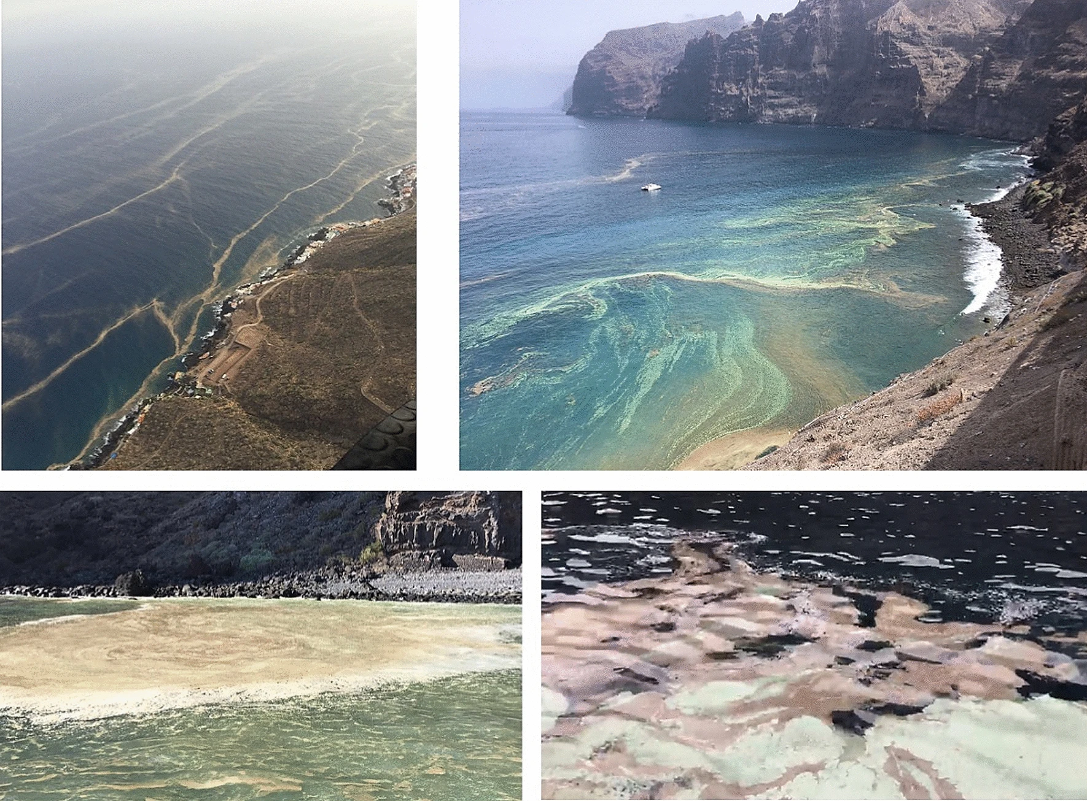
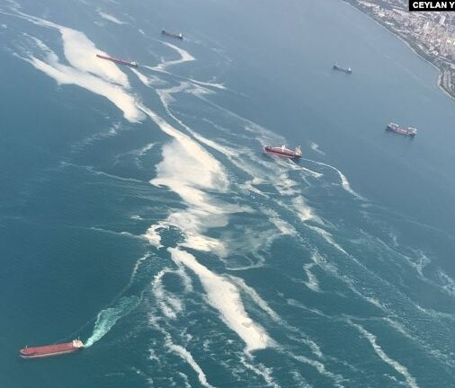
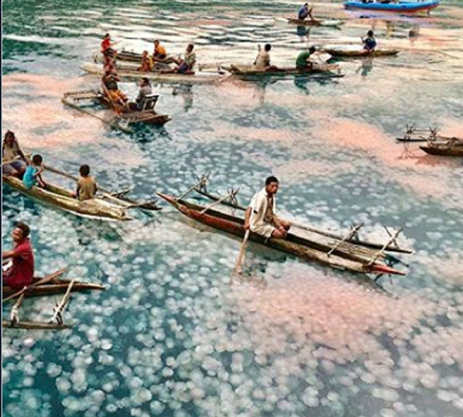
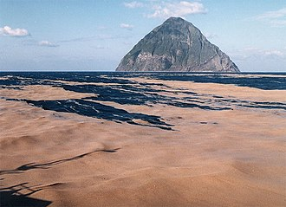
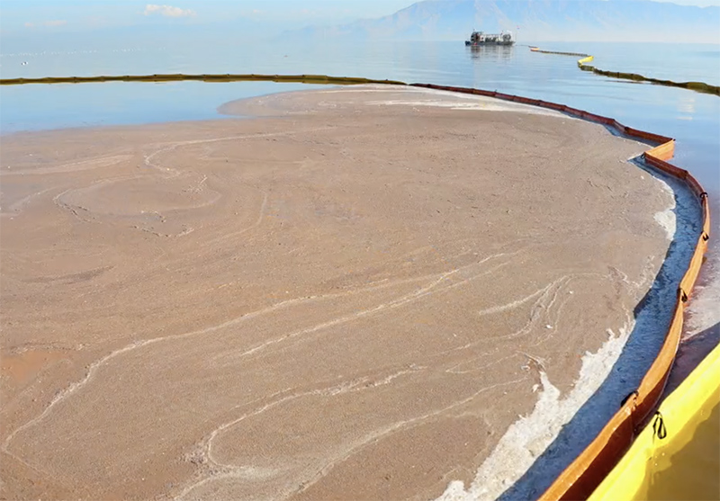
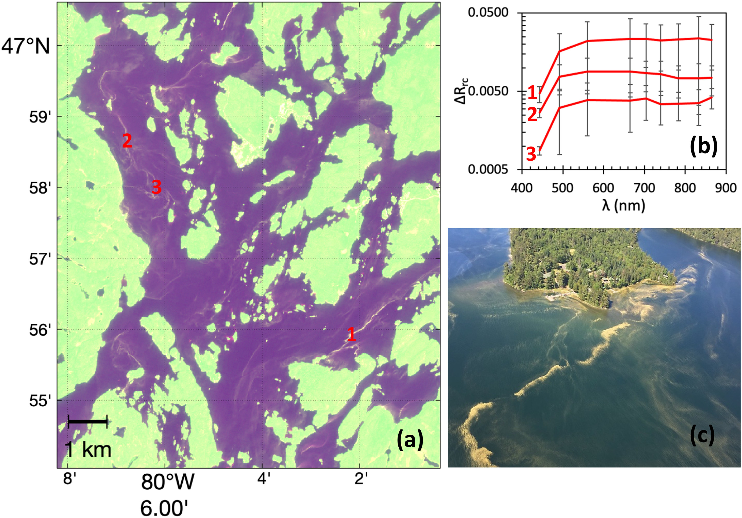
Macroalgae
Sargassum
Macroalgae
Ulva
Microalgae
Noctiluca
Microalgae
Cyanobacteria
Marine Debris
Sea Snot
Jellyfish
Sea Pumice
Shrimp Eggs
Tree Pollen
But there are various other “floating features”…

Slide 8
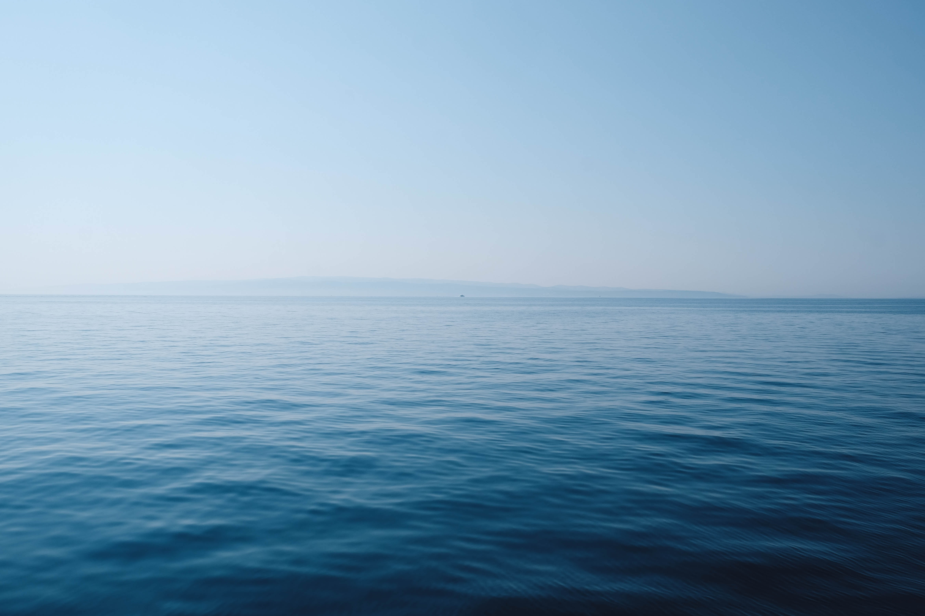
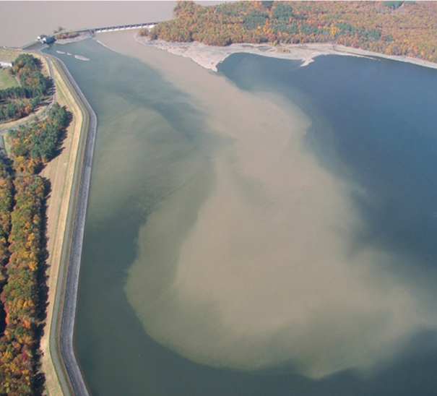
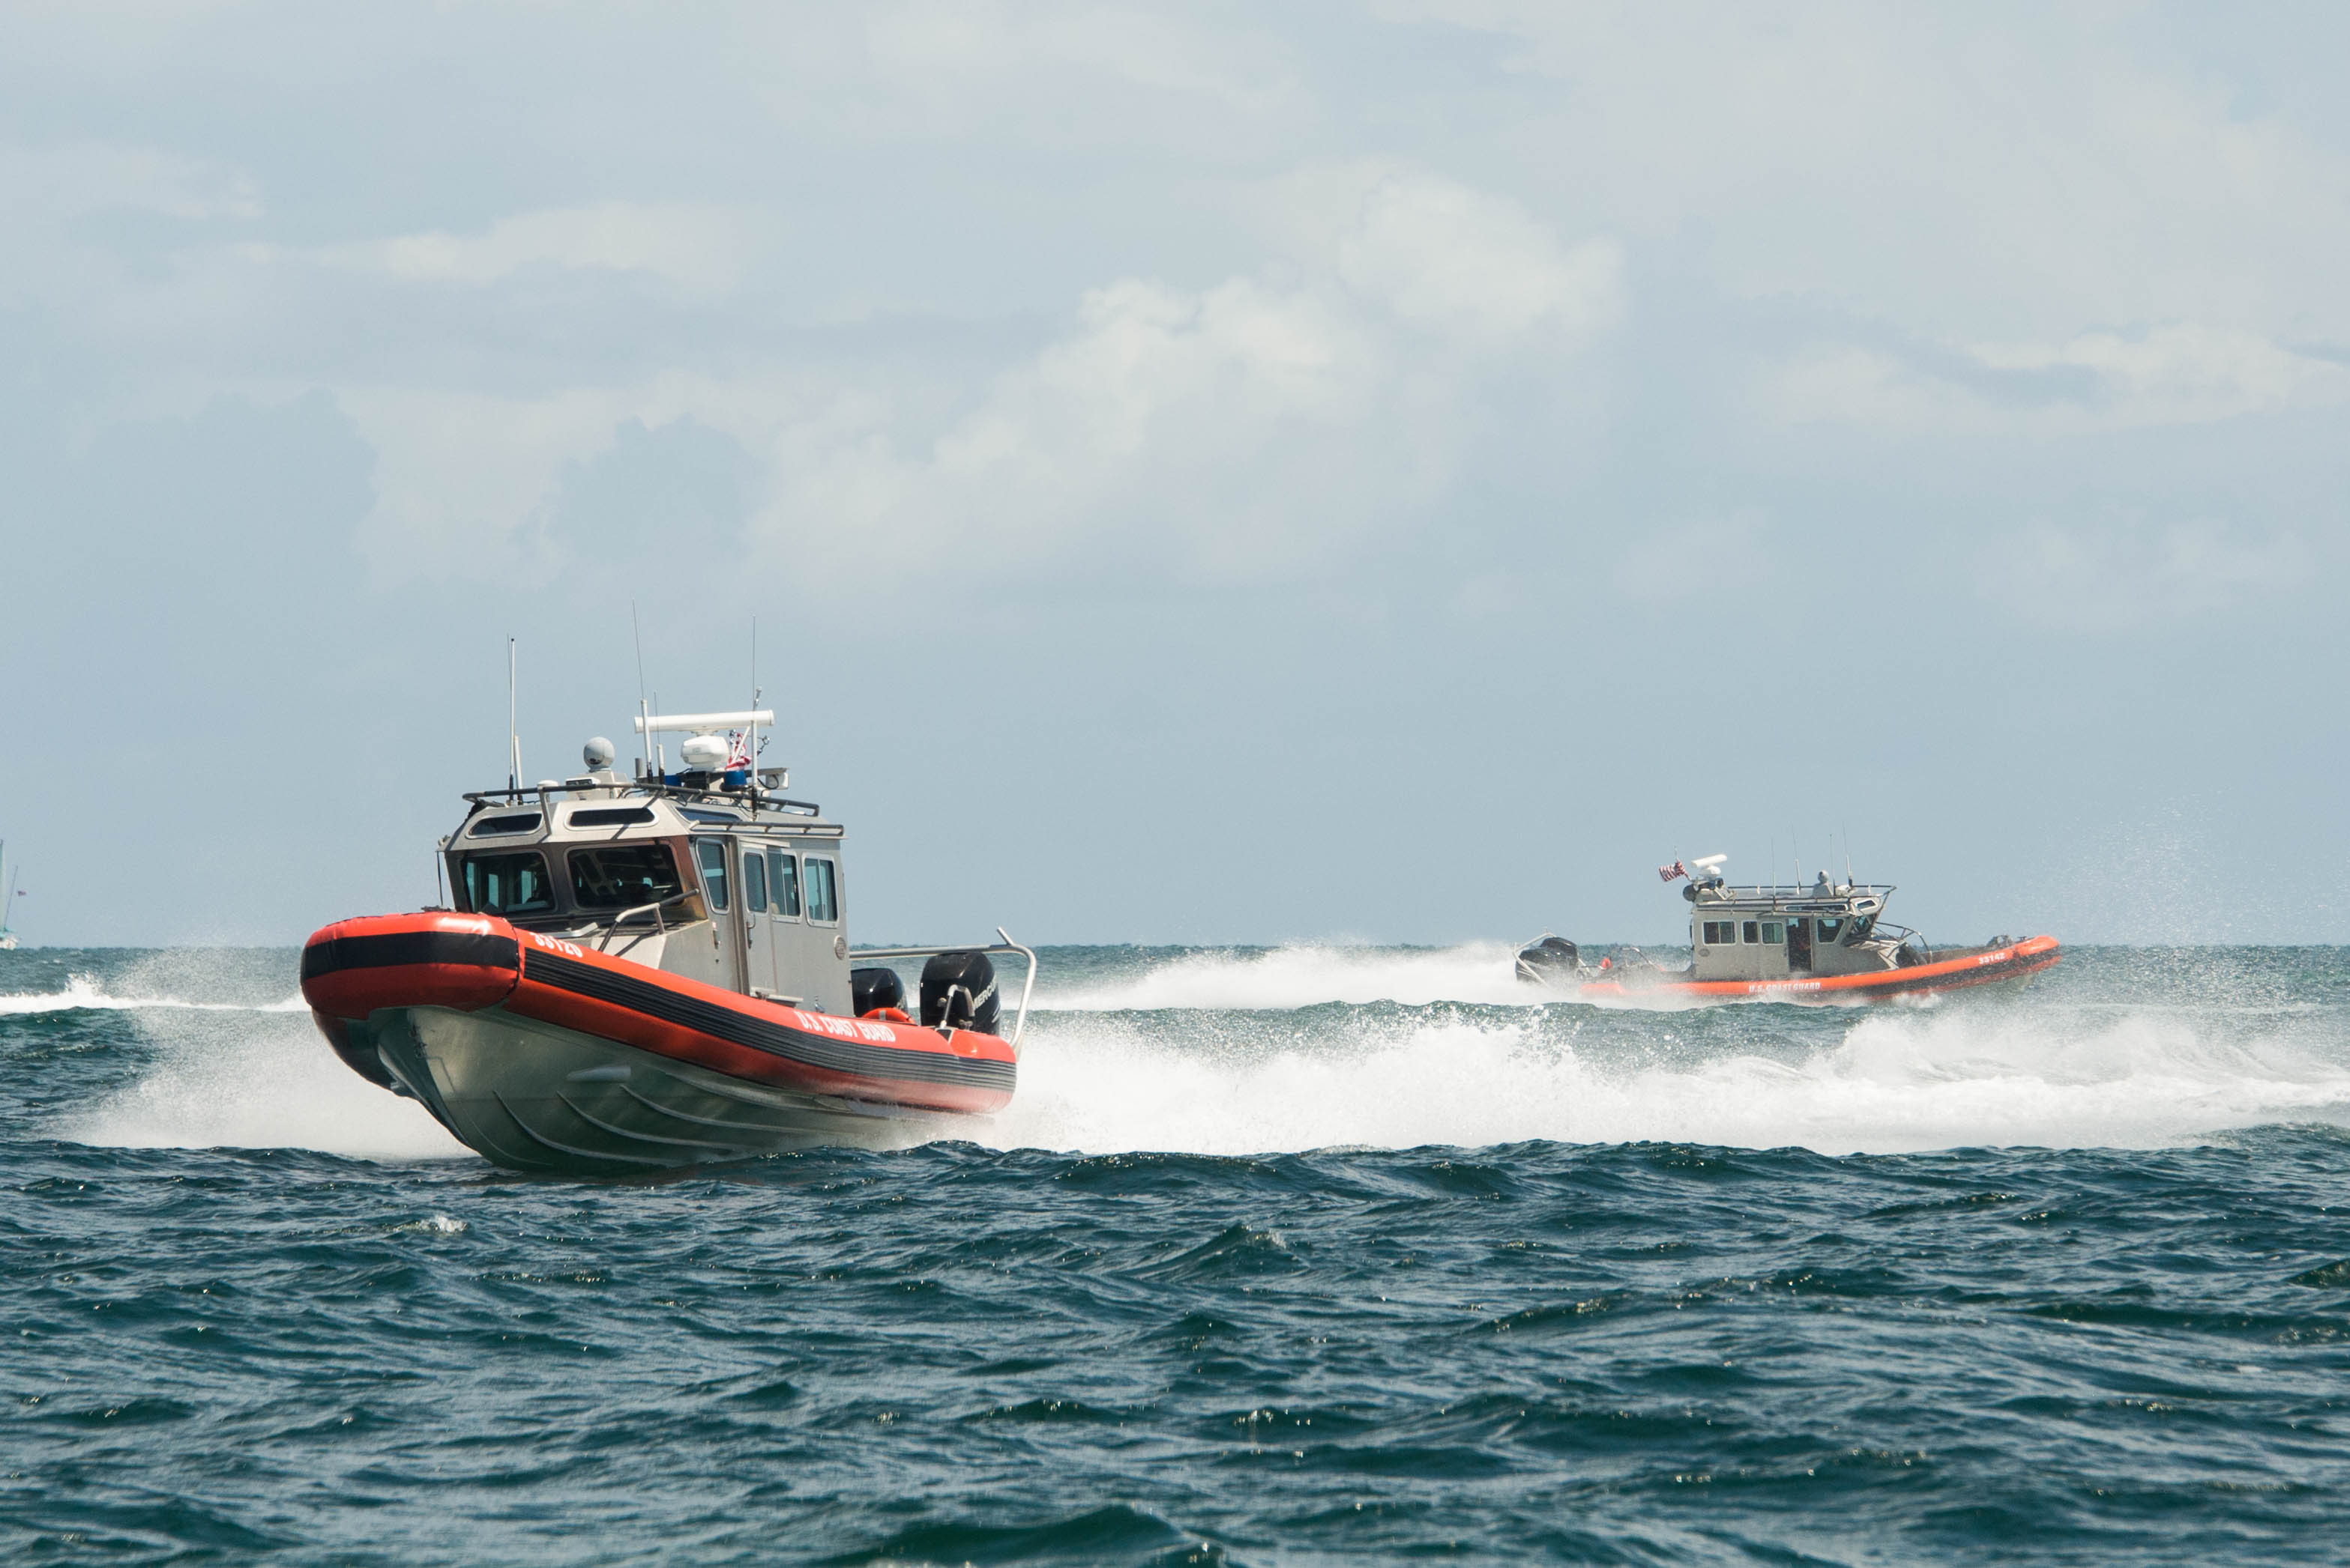
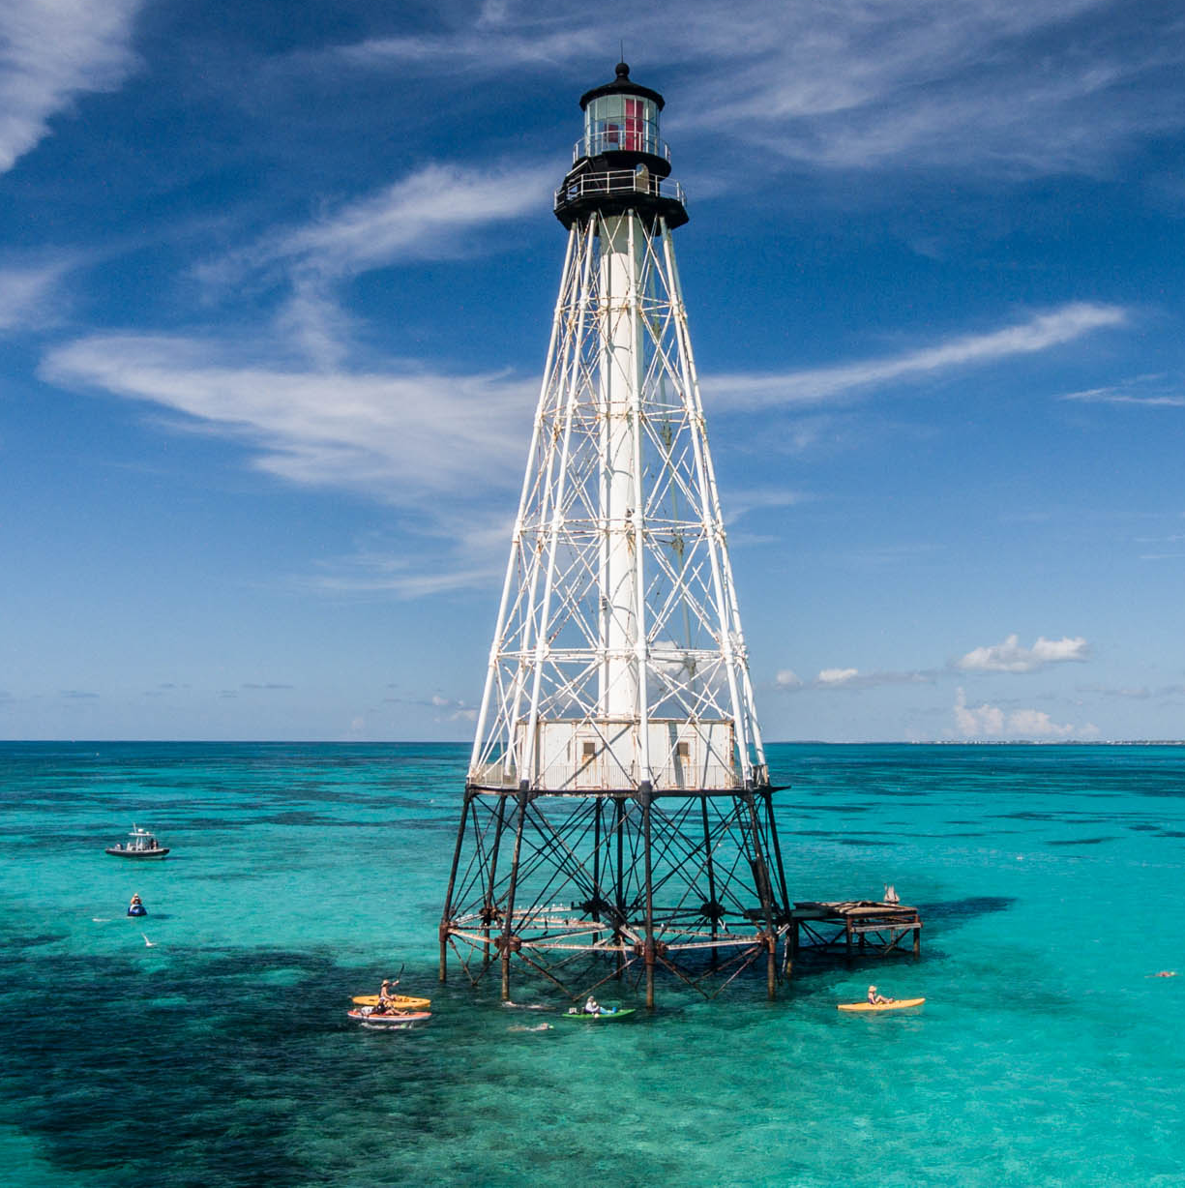
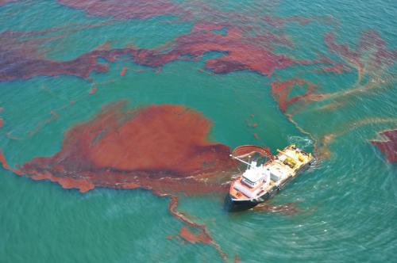
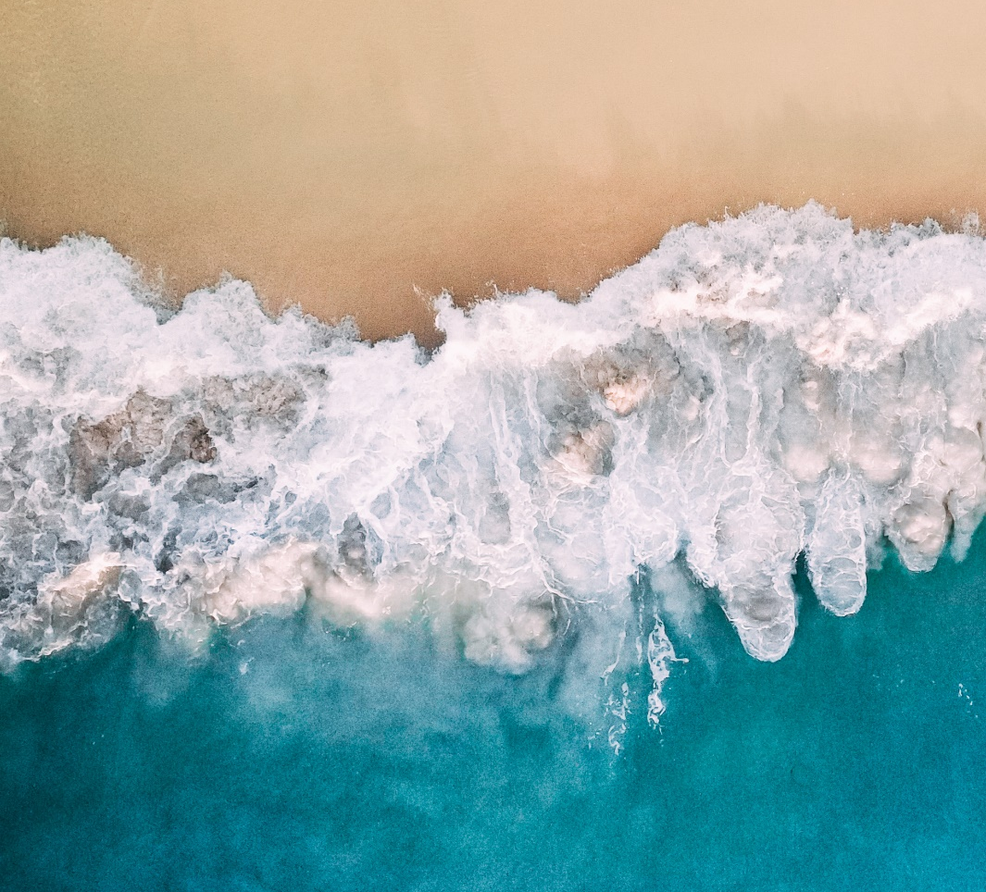
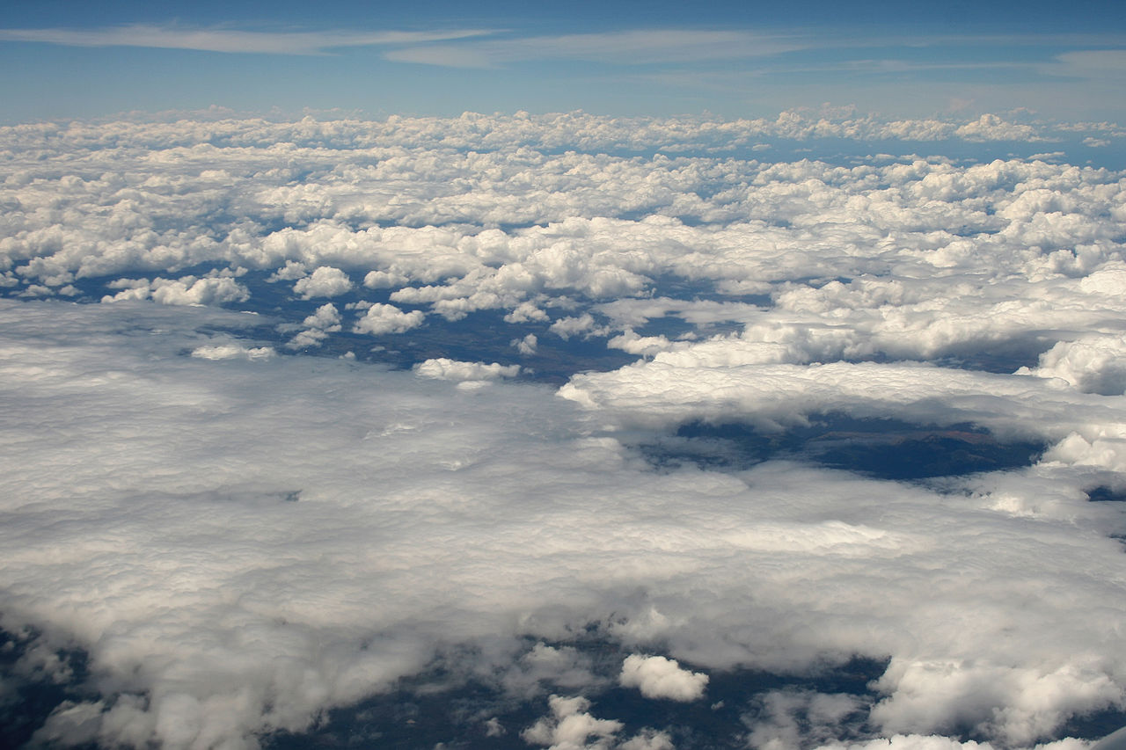
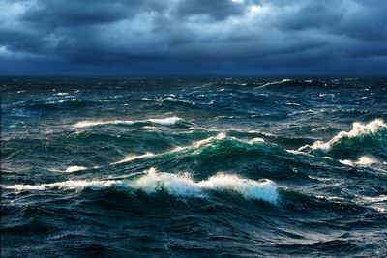
and more other features in Sentinel-2…

Slide 9
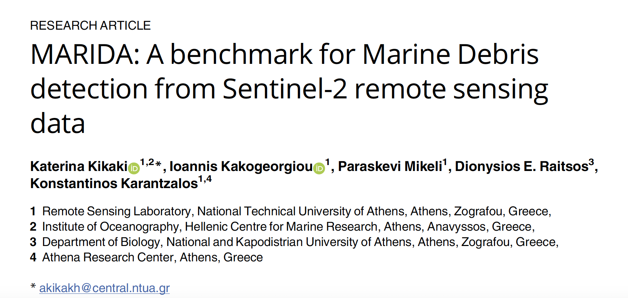
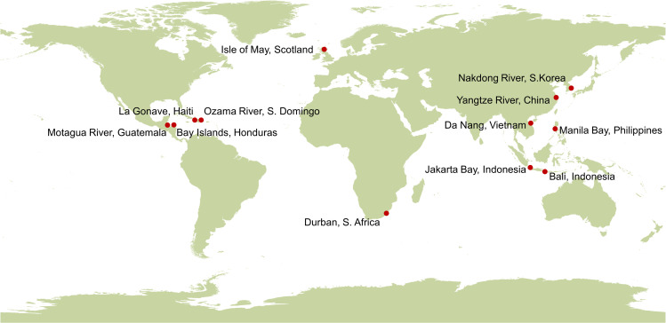
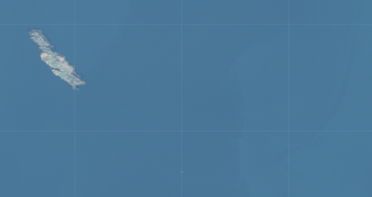
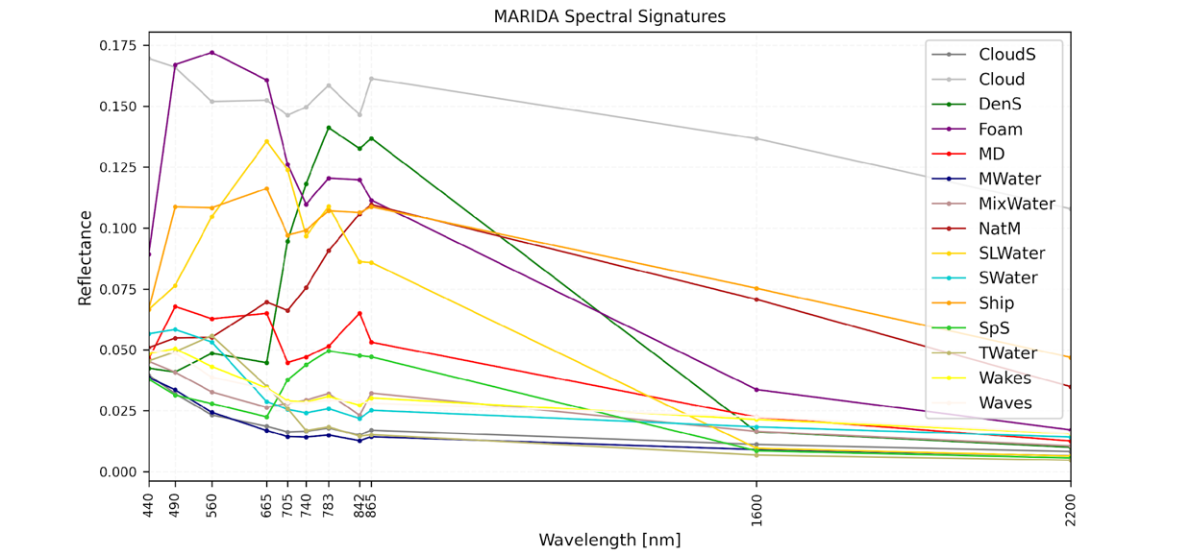
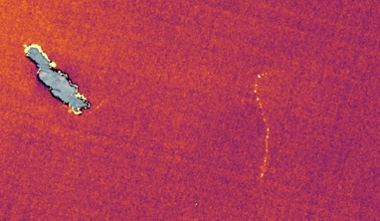
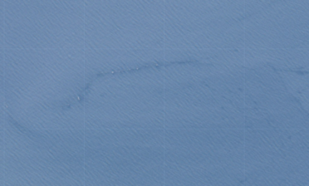
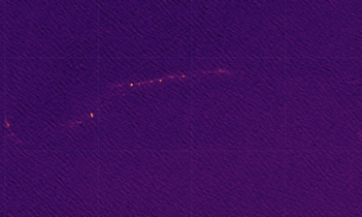
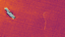
MARIDA - Marine Debris Archive
dataset based on the multispectral Sentinel-2 (S2) satellite data, which distinguishes Marine Debris from various marine features that co-exist, including Sargassum macroalgae, Ships, Natural Organic Material, Waves, Wakes, Foam, dissimilar water types (i.e., Clear, Turbid Water, Sediment-Laden Water, Shallow Water), and Clouds.
MARIDA: Marine Debris reports across different countries and continents for the period 2015–2021.
https://marine-debris.github.io/

Slide 10
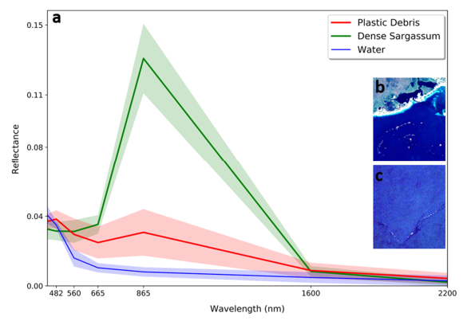

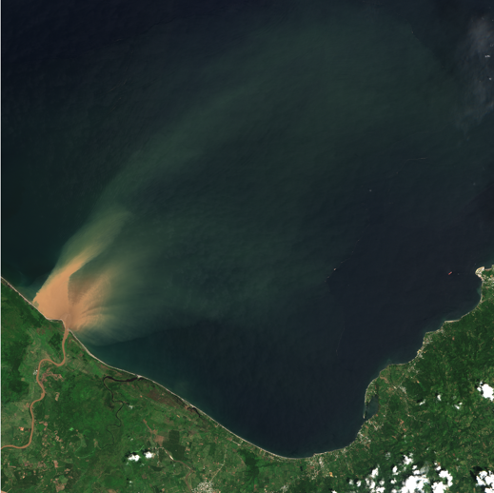


Different spectral signatures for ocean water, floating vegetation (e.g., sargassum, organic matter), floating plastics.
Machine learning techniques can help the discrimination of floating plastic debris from other features.
Ocean water – low reflectance
Floating Plastics – high reflectance w/ flat spectrum
Floating Vegetation – high reflectance w/ red edge

Slide 11



POS2IDON: Description
POS2IDON is an open-source data pipeline based on Sentinel-2, developed by AIR Centre, for long-term analyses and monitoring of suspected marine debris accumulations (>10 m) and other ocean features, such as floating organic material.
https://github.com/AIRCentre/POS2IDON

Slide 12







POS2IDON: Description
Search and Download
User Inputs
Region of Interest
Sensing Period
COAH/CDSE Credentials
Other
Search Sentinel-2 Level 1C
Free Data Provider Platforms
Copernicus Open Access Hub (COAH)
Copernicus Data Space Ecosystem (CDSE)
FeLS
https://github.com/vascobnunes/
fetchLandsatSentinelFromGoogleCloud
sentinelsat
https://github.com/sentinelsat/sentinelsat
OData
AIR Centre developed
function based on OData
Python Interfaces
Download Products

Slide 13


POS2IDON: Description
Atmospheric Correction
Top of Atmosphere
Rayleigh Atmospheric Corrected
ACOLITE
https://github.com/
acolite/acolite
Includes specific inputs that can be changed by more advanced users inside the workflow .py file

Slide 14




POS2IDON: Description
Land, Water Masking
Remove Land and leave Water where the classification will be performed. Uses ESA WorldCover 2021.
Remove some water pixels depending on thresholds to improve classification time. Uses Band 8 or Normalized Difference Water Index (NDWI).
MASKS

Slide 15


POS2IDON: Description
Cloud Masking
Remove Clouds using s2cloudless (https://github.com/sentinel-hub/sentinel2-cloud-detector).
MASKS

Slide 16



POS2IDON: Description
Inputs
Sentinel-2 Masked Product
Split and Mosaic
ML Algorithms and Models
Other
Random Forest
XGBoost
UNet
Machine Learning Algorithms
Default model:
- Hyperparameters based on MARIDA RF_{SS+SI}
- 19 ML features: 'B01', 'B02', 'B03', 'B04', 'B05', 'B06', 'B07', 'B08', 'B8A', 'B11', 'B12', 'NDVI', 'FAI', 'FDI', 'SI', 'NDWI', 'NRD', 'NDMI', 'BSI’
Several variations of the original MARIDA RF_{SS+SI} are presented in the following slides
Default model:
- Hyperparameters based on Cross-Validation
- 19 ML features: 'B01', 'B02', 'B03', 'B04', 'B05', 'B06', 'B07', 'B08', 'B8A', 'B11', 'B12', 'NDVI', 'FAI', 'FDI', 'SI', 'NDWI', 'NRD', 'NDMI', 'BSI’
It will not be the focus of this presentation, but POS2IDON supports it
Default model:
- Hyperparameters based on MARIDA Unet
- 11 ML features: 'B01', 'B02', 'B03', 'B04', 'B05', 'B06', 'B07', 'B08', 'B8A', 'B11', 'B12’
More information:
Kikaki et al, 2022. MARIDA: A benchmark for Marine Debris detection from Sentinel-2 remote sensing data
It will not be the focus of this presentation, but POS2IDON supports it
Classification

Slide 17






POS2IDON: Models
 | RF |  |  | XGBoost
Class | IoU | Rec | F1 | IoU | Rec | F1
MD | 0.68 | 0.83 | 0.81 | 0.73 | 0.84 | 0.84
DenseS | 0.92 | 0.95 | 0.96 | 0.93 | 0.96 | 0.96
SpS | 0.82 | 0.90 | 0.90 | 0.85 | 0.90 | 0.92
NatM | 0.73 | 0.80 | 0.85 | 0.75 | 0.81 | 0.86
Ship | 0.69 | 0.75 | 0.82 | 0.76 | 0.81 | 0.86
Clouds | 0.93 | 0.96 | 0.96 | 0.97 | 0.98 | 0.98
MWater | 0.94 | 0.97 | 0.97 | 0.97 | 0.99 | 0.98
SLWater | 1.00 | 1.00 | 1.00 | 1.00 | 1.00 | 1.00
Foam | 0.59 | 0.74 | 0.74 | 0.66 | 0.78 | 0.80
TWater | 0.99 | 1.00 | 1.00 | 0.99 | 1.00 | 1.00
SWater | 0.93 | 0.96 | 0.96 | 0.96 | 0.97 | 0.98
Cyanob | 1.00 | 1.00 | 1.00 | 1.00 | 1.00 | 1.00
Noctil | 0.99 | 0.99 | 0.99 | 0.99 | 1.00 | 1.00
Phaeoc | 0.86 | 0.94 | 0.92 | 0.91 | 0.96 | 0.95
Average | 0.86 | 0.91 | 0.92 | 0.89 | 0.93 | 0.94
Random Forest and XGBoost ML models show satisfactory metrics. An improved U-NET model is under testing.
Models were trained with an extended version of the MARIDA spectral library, totalizing 14 classes, including Marine Debris, Floating Macroalgae, Ships, Foam, Clear and Turbid Water and Phytoplankton Blooms.
However, challenges are always present in unseen data…
Many other reflective/bright features like plastics exist, foam, clouds, ships. Difficult to differentiate between these features

Slide 18


Julia UNET integration into Python
The UNET model was developed with the Flux.jl package.
The integration of the model structure into POS2IDON main code in Python is assured by JuliaCall from PythonCall.jl.
This allows the POS2IDON user to have more machine learning model options and take advantage of Julia's processing capabilities.

Slide 19

POS2IDON: Applications (1)
Post-disaster management after flooding events in heavily polluted regions to direct clean-up activities and assess the input of debris into the ocean. Next figure shows POS2IDON applied to a major plastic debris event in Honduras Gulf in 2020/09/18.
Likely presence of MD (red pixels and dots) detected along the river front. Red stars with white borders are clusters of at least 10 MD pixels at 100 meters distance.

Slide 20

POS2IDON: Applications (2)
Long-term seasonal analysis taking advantage of regular Sentinel-2 imagery (5 days) since 2018, useful to better understand patterns and trends in marine debris. POS2IDON is used to analyse Honduras Gulf for all 2020 (72 images).
Dryer seasons (winter and spring) have less debris detection, in agreement with rivers being the major source of pollution.

Slide 21






Improvements since last JuliaEO
GEOSAT-2 very-high resolution
Events in Literature and News
2023-06-30 ALKOR in-situ
ALKOR, Geomar
2023-06-30 GEOSAT-2 RGB
Field Campaign June 2023 (LABPLAS project)

Slide 22

Improvements since last JuliaEO
Support for the new Copernicus Data Space Ecosystem for downloading Sentinel-2 products.
From JuliaEO23 a collaboration start to train a UNET model in Julia to improve GPU classification speed.
Integration of the UNET model developed in Julia into the POS2IDON source code in Python;
Web app prototype to show POS2IDON results (using Python folium, how can Julia facilitate this web development?);

Slide 23


Improvements since last JuliaEO
Visualization and analysis of long-term data with density and occurrence maps.
GEOTIF may not be the most efficient way to save POS2IDON results during long-term analysis (alternative formats?).
Training new models with an expanded spectral library containing more classes such as algae blooms. However, there is still a problem of lack of in-situ data.

Slide 24



Introduction to Case Study – South Africa Floods 2022
Our case study is an event of litter discharged to the sea following the April 2022 catastrophic floods in KwaZulu Natal, South Africa.
Plastic pollution left behind on Durban's beaches after the April 2022 floods.
Sentinel-2 RGB image on 13-04-2022

Slide 25


What will be covered?
Focus on this Hands-on session
The Hands-on session is a simplified version of POS2IDON.
You can access the training material and instructions at:
AIRCentre > JuliaEO24 > notebooks > pos2idon_results_demo
In addition, a document with basic instructions was sent to you.
Visualization
Classification with RF
POS2IDON architecture.

Slide 26

Some questions you might have
Before we start the Hands-on session, here are some important questions answered:
What is Docker?
Docker enables the creation of lightweight, isolated containers for applications and their dependencies. This is valuable because it ensures consistent environments and offers portability. It streamlines this kind of hands-on sessions by ensuring all participants have a uniform and manageable environment to run a specific project.
Where does the data used in the exercise come from?
data
MARIDA_RF-model
S2A_MSI_2022_04_13_08_08_18_T36JUN_stack.tif
Previous trained Random Forest model based on the MARIDA spectral signatures library.
Recall for Marine Debris: 91%
Stack processed and outputted by POS2IDON.
Includes:
- 11 Sentinel-2 bands atmospherically corrected with ACOLITE and resampled to 10 meters.
- 8 Spectral Indices calculated from the previous bands.
Measures how good your model finds all the positives.
$$Recall=\frac{TP}{TP+FN}$$

Slide 27
Let’s go!

